Slide 1
Predict Bitcoin’s price using other cryptocurrencies

Slide 2

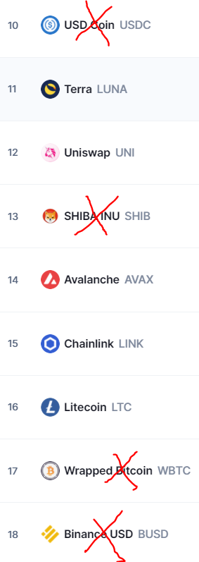

Use LSTM Machine Learning to predict Bitcoin’s price using other cryptocurrencies from the top 20 chart

Slide 3
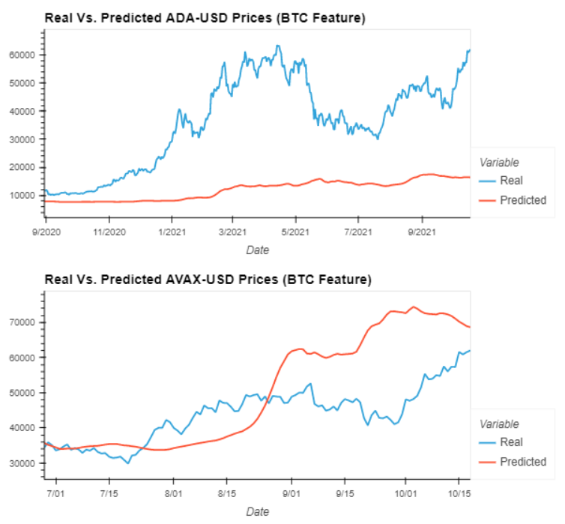
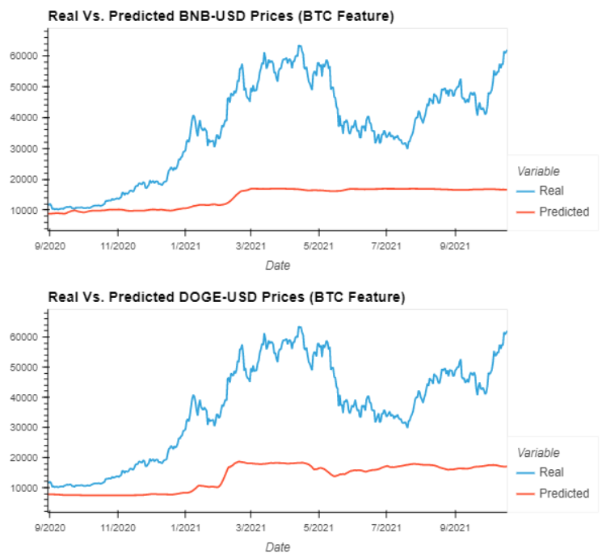
Crypto predicts BTC using 4 Years of Data

Slide 4
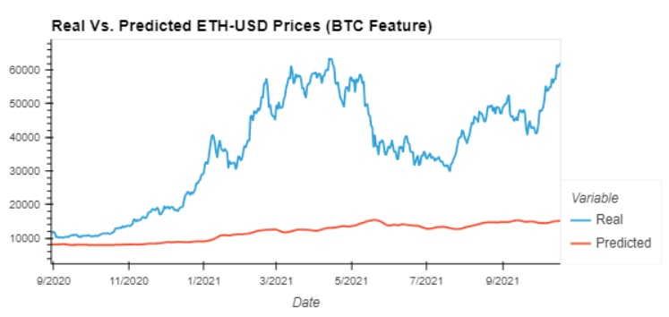
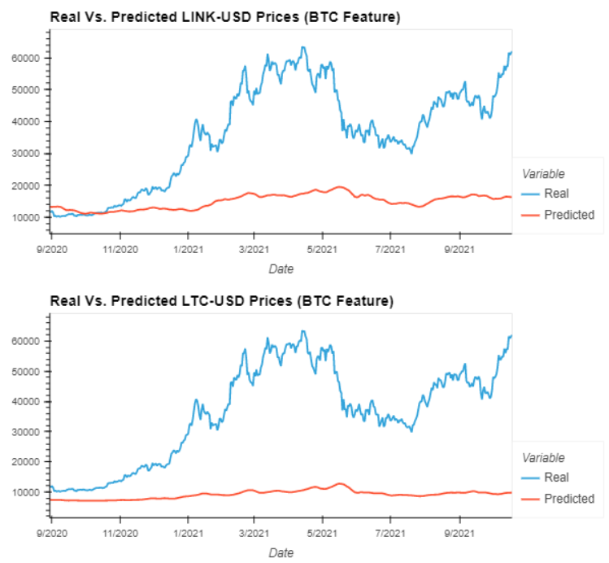
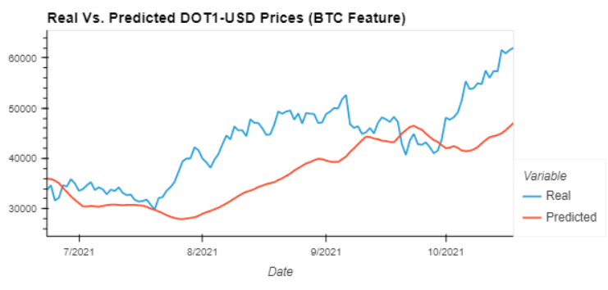
Crypto predicts BTC using 4 Years of Data

Slide 5
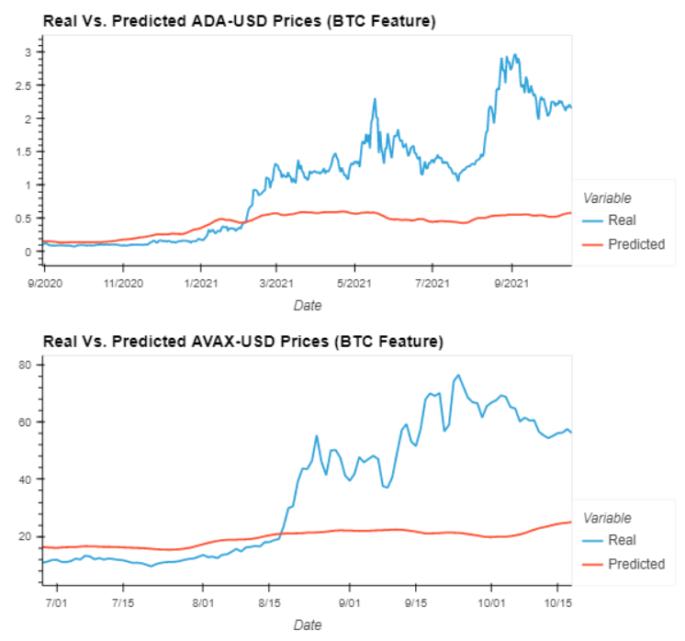
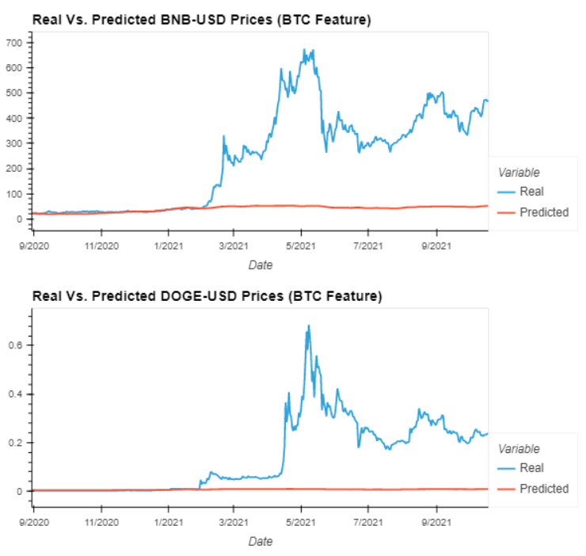
BTC predicts Cryptos using 4 Years of Data

Slide 6
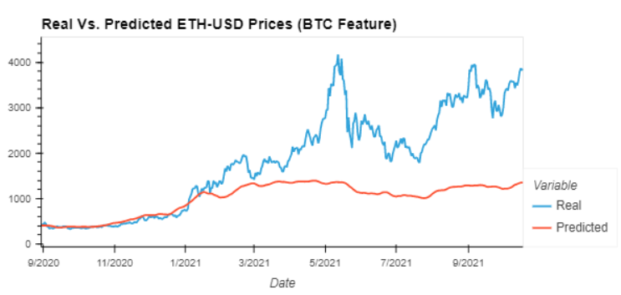
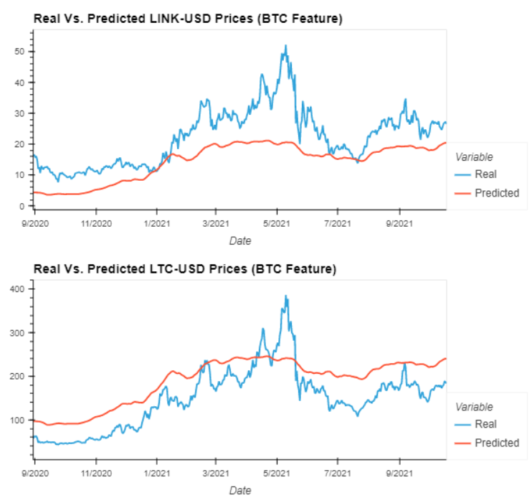
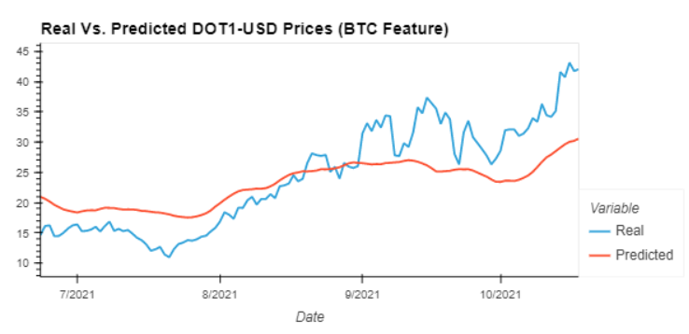
BTC predicts Cryptos using 4 Years of Data

Slide 7
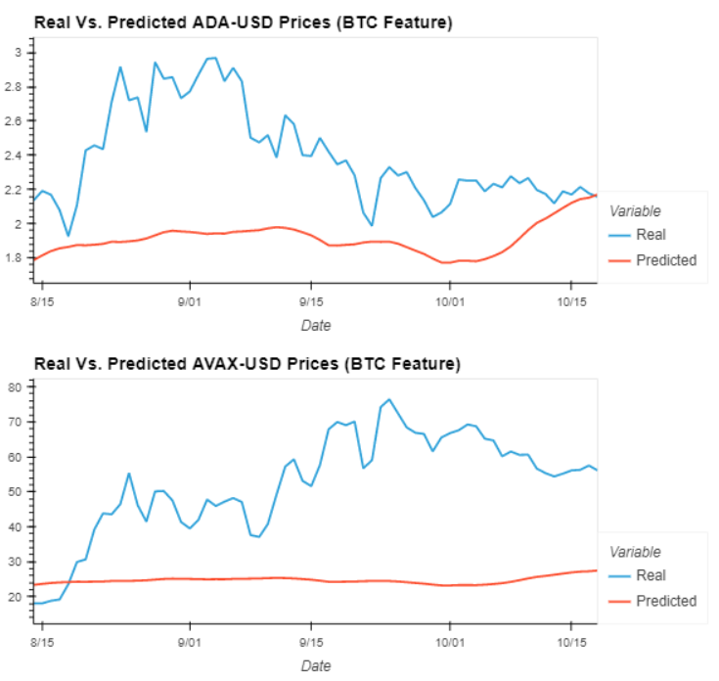
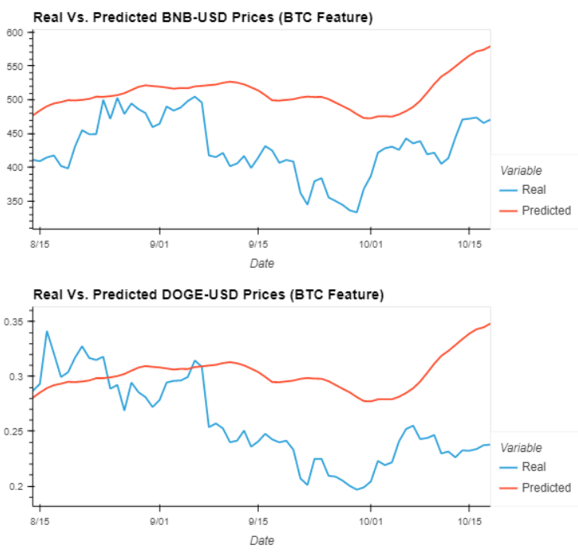
BTC predicts Cryptos using 1 Year of Data

Slide 8
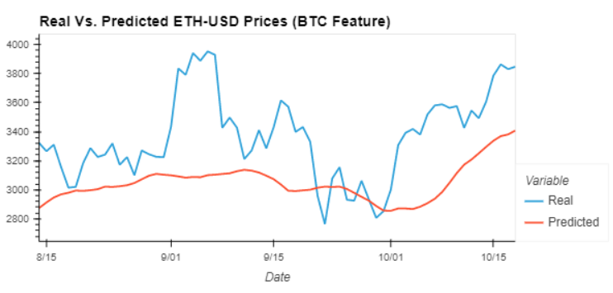
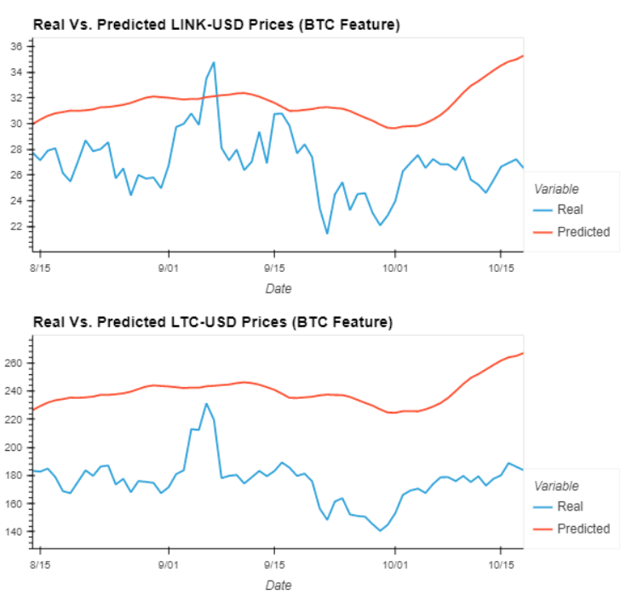
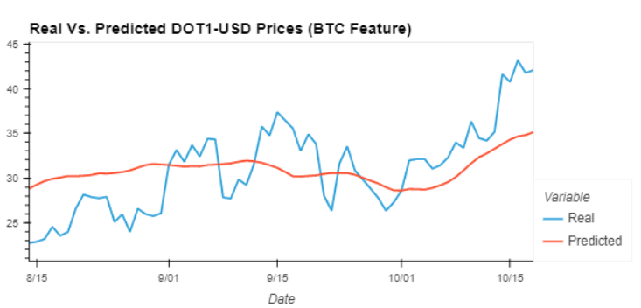
BTC predicts Cryptos using 4 Years of Data

Slide 9
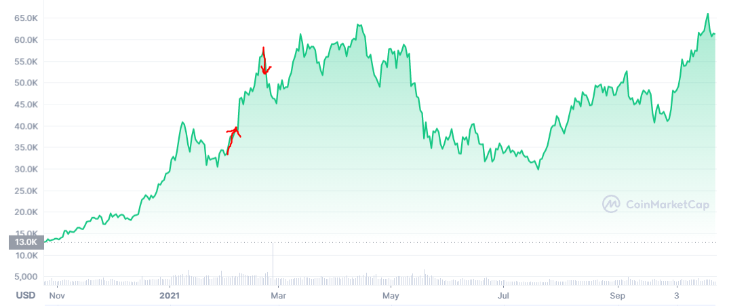
Buy and Sell Trading Algorithm
Strategy : Start with $1000 worth of crypto
At Y% below top
Sell 10% of the value
of your crypto
At X% above bottom
Buy 10% of the value of your crypto

Slide 10
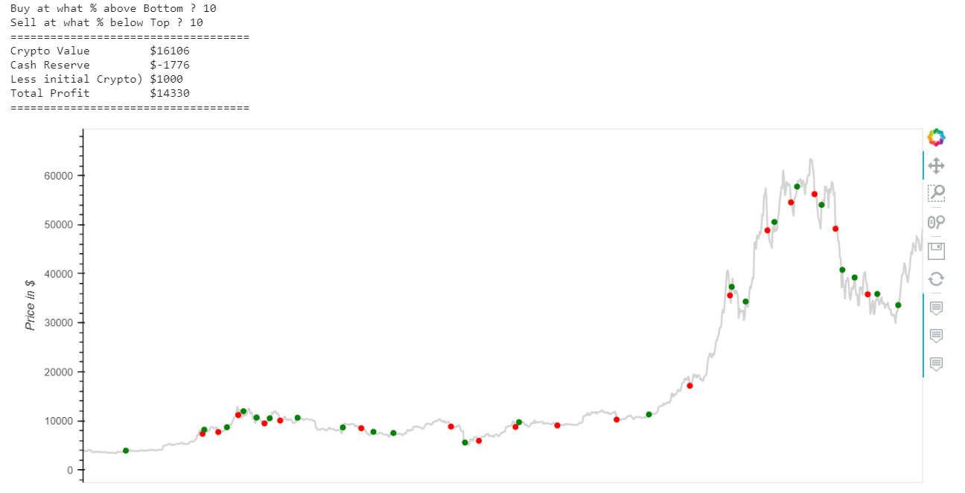

Slide 11
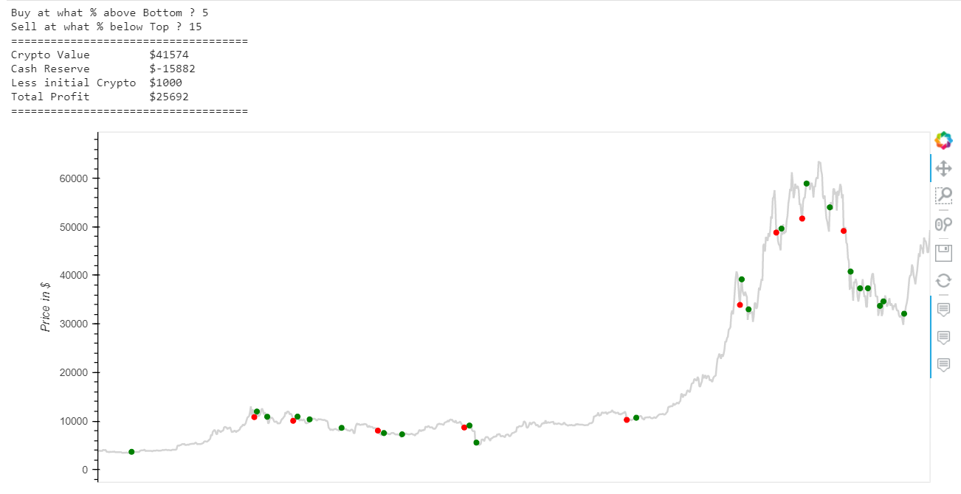

Slide 12
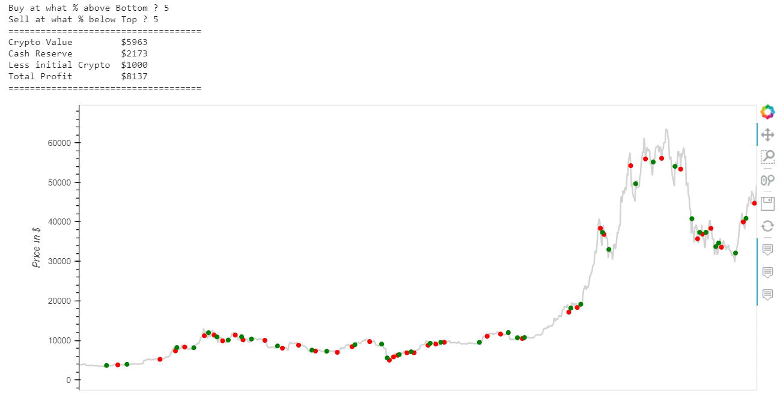

Slide 13
